Slide 1
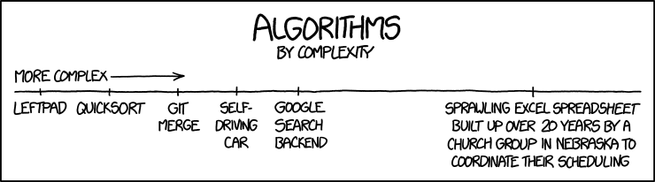
Lesson 10: Algorithms
I should make a algorithm to generate these PowerPoints
Ben Schwarz
*Large parts of this lesson were made by Tom Schwarz

Slide 2
Lesson 10: Algorithms
What is an algorithm?
An algorithm is a set of instructions to complete a task
For example:
Finding the door in a room: Check a wall. If it has the door, yay! If it dosen’t, repeat with the wall on the right.
Finding a book on a bookcase: Look through all books and check if it’s the right book
If you remember from last week, figuring out how to complete a task is an important step, before you actually program the computer to do the task
i.e. You need to figure out what you will tell the computer to do, before you tell it.

Slide 3
Lesson 10: Algorithms
Let’s try designing an algorithm!
How could we sort a random list of numbers to be ascending?
E.g. make [6, 3, 2, 84, 1] into [1, 2, 3, 6, 84]
Notes:
Think about:
How would we solve this manually?
Is this the fastest way?
Introduce big O to understand the time it will take to run, then explain how some algorithms are better than others.

Slide 4
Lesson 10: Algorithms – Designing algorithms
Think about the inputs & outputs of the algorithm
What data do you have to work with
What are you trying to achieve
Break down the problem into smaller segments
Think about how you would solve the problem on paper

Slide 5
Lesson 10: Algorithms
Selection Sort:
Loop through the list, find the smallest item and add it to a new list. Repeat.
Quick Sort (generally considered fastest sort):
Splits list into two, with one list containing upper half of numbers, other lower half. Then repeats…

Slide 6
Lesson 10: Algorithms
Insertion Sort:
Loop through the list, find the smallest item and add it to a new list. Repeat.
Quick Sort (generally considered fastest sort):
Splits list into two, with one list containing upper half of numbers, other lower half. Then repeats…
Insertion Sort Quick Sort Quick Sort (Slow so you can see)

Slide 7
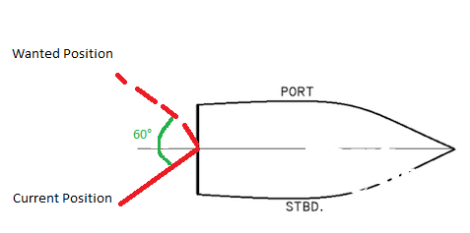
Lesson 10: Algorithms
Let’s design another algorithm!
Imagine we’re on a ship an we want to turn the rudder 60° (with a computer)
How should we do this?

Slide 8

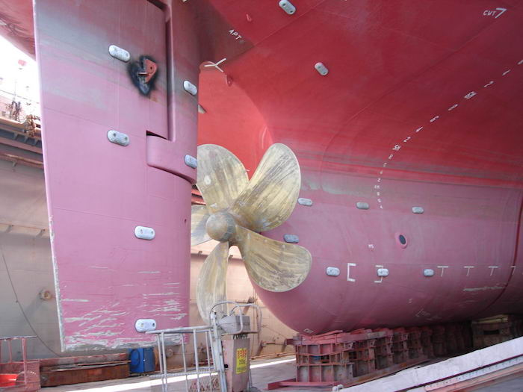
Lesson 10: Algorithms
Let’s design another algorithm!
Imagine we’re on a ship an we want to turn the rudder 60° (with a computer)
How should we do this?
However, we have an important limitation:
The rudder is very heavy, and has lots of momentum – it continues to turn a bit even after we stop turning it, and it takes a while to start moving

Slide 9
Lesson 10: Algorithms
PID
PID is a very common algorithm to solve this exact problem
PID takes an error (how far off the ruder is), and provides an output – say the energy to give to the engine.
PID has three parts:
P: Proportional – a proportional response to the error
I : Integral – a cumulative response to the error
D : Derivative – a predictive response to the error based on the rate of change
I is useful for fixing ‘steady-state-error’ – when the output (ruder) is slightly off, but not enough for P to manage to move it – I builds up in till it makes it move.

Slide 10
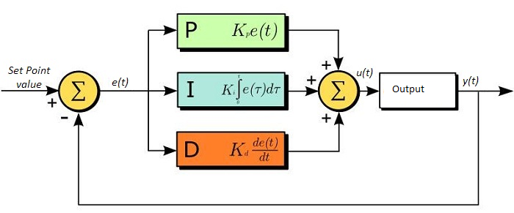
Lesson 10: Algorithms
The three sections (P, I & D) are summed together
However, before they are summed, each section is multiplied by a special value
These values are the three constants K_{p} , K_{I} & K_{D}
These values are different for every system, because each system responds differently – with different amounts of lag, momentum, units and energy
These values are found through the process of tuning – essentially trial and error

Slide 11
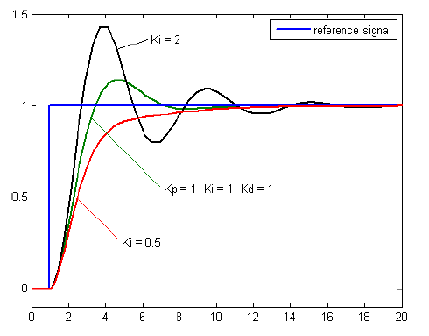
Lesson 10: Algorithms
Here we can see the three responses
P (Green) overshoots a bit but returns eventually
I oscillates around forever
D slowly approaches it
Combined the three responses work quite well

Slide 12
Lesson 10: Algorithms
PID is commonly used to control systems on the robot, to quickly get to a desired position
PID is also heavily used in industry
https://youtu.be/fusr9eTceEo
https://youtu.be/K-F_T59ZDPw

Slide 13
Activities (These are optional and are designed to test you) These are the last problems before we move on to OOP:
When squirrels get together for a party, they like to have cigars. A squirrel party is successful when the number of cigars is between 40 and 60, inclusive. Unless it is the weekend, in which case there is no upper bound on the number of cigars. Return true if the party with the given values is successful, or false otherwise.
cigarParty(30, false) → false cigarParty(50, false) → true cigarParty(70, true) → true
You and your date are trying to get a table at a restaurant. The parameter "you" is the stylishness of your clothes, in the range 0..10, and "date" is the stylishness of your date's clothes. The result getting the table is encoded as an int value with 0=no, 1=maybe, 2=yes. If either of you is very stylish, 8 or more, then the result is 2 (yes). With the exception that if either of you has style of 2 or less, then the result is 0 (no). Otherwise the result is 1 (maybe). dateFashion(5, 10) → 2 dateFashion(5, 2) → 0 dateFashion(5, 5) → 1
We want to make a row of bricks that is goal inches long. We have a number of small bricks (1 inch each) and big bricks (5 inches each). Return true if it is possible to make the goal by choosing from the given bricks. This is a little harder than it looks and can be done without any loops.
makeBricks(3, 1, 8) → true makeBricks(3, 1, 9) → false makeBricks(3, 2, 10) → true
We want to make a package of goal kilos of chocolate. We have small bars (1 kilo each) and big bars (5 kilos each). Return the number of small bars to use, assuming we always use big bars before small bars. Return impossible if it can't be done.
makeChocolate(4, 1, 9) → 4 makeChocolate(4, 1, 10) → -1 makeChocolate(4, 1, 7) → 2
Source: http://codingbat.com/java

